Slide 1
Chapter 2:
Modeling Data in the Organization
Essentials of Database Management
Jeffrey A. Hoffer, Heikki Topi, V. Ramesh
Copyright © 2014 Pearson Education, Inc.

Slide 2

OBJECTIVES
Define terms
Understand importance of data modeling
Write good names and definitions for entities, relationships, and attributes
Distinguish unary, binary, and ternary relationships
Model different types of attributes, entities, relationships, and cardinalities
Draw E-R diagrams for common business situations
Convert many-to-many relationships to associative entities
Model time-dependent data using time stamps

Slide 3

MODELING REALITY
A database must mirror the real world if it is to answer questions about the real world
Data Modeling is a design technique for capturing reality
STUDENT
Social_Security_No
Name
Major

Slide 4
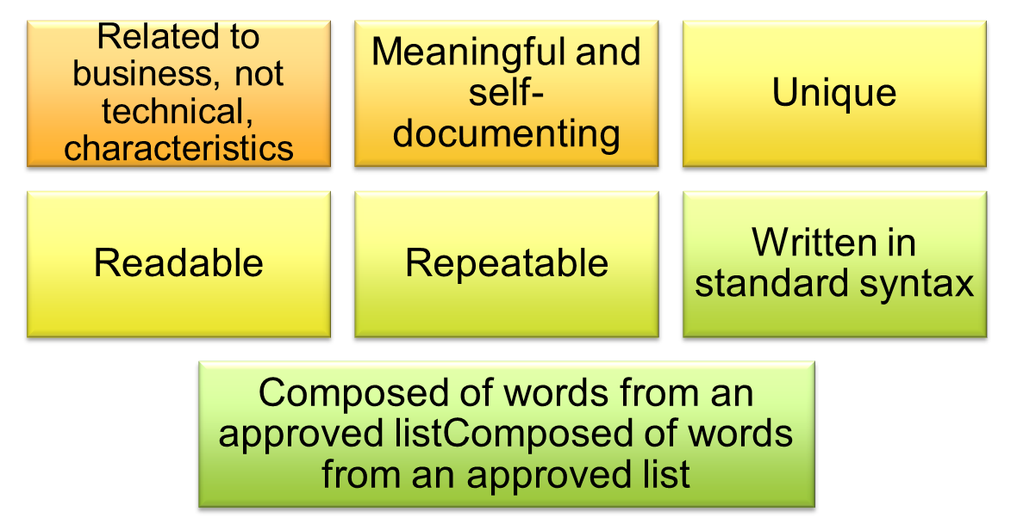
A GOOD DATA NAME IS:

Slide 5
DATA DEFINITIONS
Explanation of a term or fact
  Term–word or phrase with specific meaning
  Fact–association between two or more terms
Guidelines for good data definition
  A concise description of essential data meaning
  Gathered in conjunction with systems requirements
  Accompanied by diagrams
  Achieved by consensus, and iteratively refined

Slide 6

KONSTRUKSI MODEL ENTITY-RELATIONSHIP (ER)
Entities:
  Entity instance–person, place, object, event, concept (often corresponds to a row in a table)
  Entity Type–collection of entities (often corresponds to a table)
Relationships:
  Relationship instance–link between entities (corresponds to primary key–foreign key equivalencies in related tables)
  Relationship type–category of relationship…link between entity types
Attributes:
  Properties or characteristics of an entity or relationship type (often corresponds to a field in a table)

Slide 7

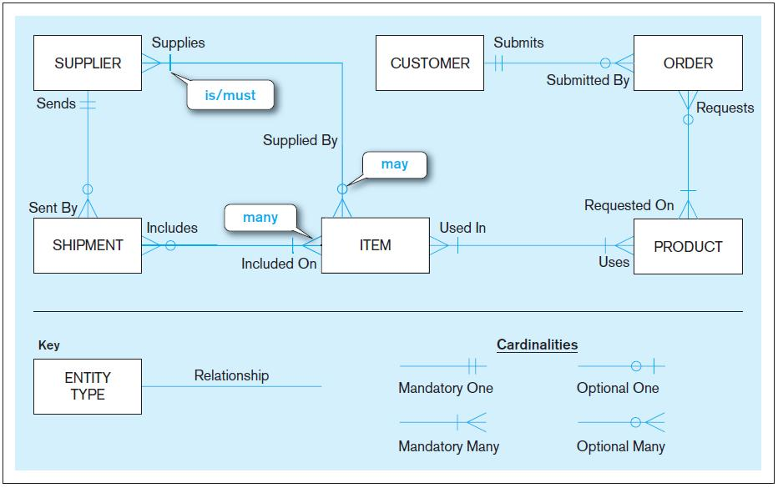
Sample E-R Diagram (Figure 2-1)

Slide 8
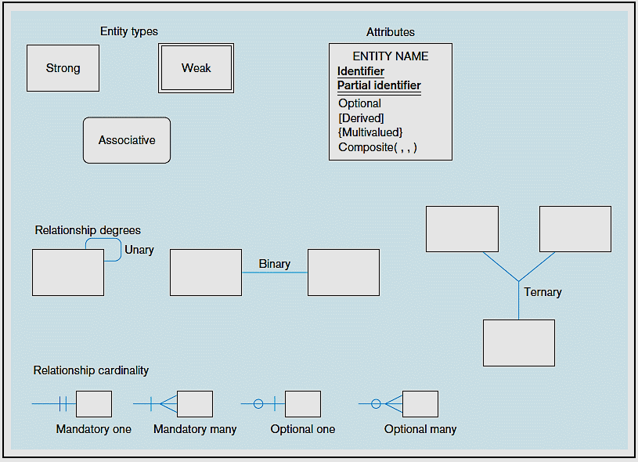
Entity symbols
Attribute symbols
A special entity that is also a relationship
Relationship symbols
Relationship degrees specify number of entity types involved
Relationship cardinalities specify how many of each entity type is allowed

Slide 9
Elements of an E-R diagram – Chen*
ENTITY
WEAK
ENTITY
ASSOCIATIVE
ENTITY
ATTRIBUTE
MULTIVALUED
ATTRIBUTE
DERIVED
ATTRIBUTE
RELATIONSHIP
INDENTIFYING
RELATIONSHIP

Slide 10

BUSINESS RULES
Are statements that define or constrain some aspect of the business
Are derived from policies, procedures, events, functions
Assert business structure
Control/influence business behavior
Are expressed in terms familiar to end users
Are automated through DBMS software

Slide 11
A Good Business Rule Is:
Declarative–what, not how
Precise–clear, agreed-upon meaning
Atomic–one statement
Consistent–internally and externally
Expressible–structured, natural language
Distinct–non-redundant
Business-oriented–understood by business people

Slide 12
DATA DEFINITIONS
EXPLANATION OF A TERM OR FACT
GUIDELINES FOR GOOD DATA DEFINITION
  Term–word or phrase with specific meaning
  Fact–association between two or more terms
  A concise description of essential data meaning
  Gathered in conjunction with systems requirements
  Accompanied by diagrams
  Achieved by consensus, and iteratively refined

Slide 13


A Good Data Name Is:
Related to business, not technical, characteristics
Meaningful and self-documenting
Unique
Readable
Composed of words from an approved list
Repeatable
Written in standard syntax

Slide 14
ENTITIES
ENTITY
a person, a place, an object, an event, or a concept in the user environment about which the organization wishes to maintain data
ENTITY TYPE
a collection of entities that share common properties or characteristics
ENTITY INSTANCE
A single occurrence of an entity type

Slide 15

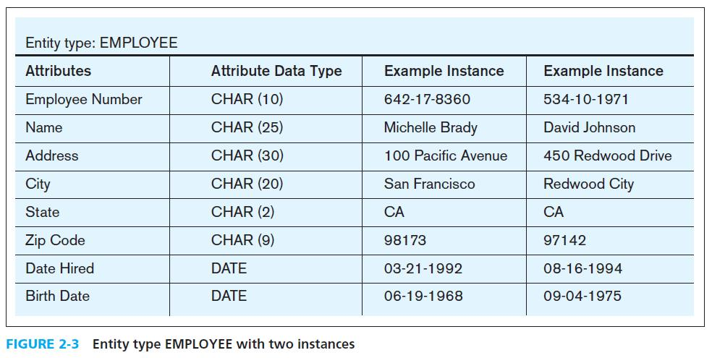
Entity Type and Entity Instances

Slide 16
AN ENTITY:
SHOULD BE:
An object that will have many instances in the database
An object that will be composed of multiple attributes
An object that we are trying to model
SHOULD NOT BE
A user of the database system
An output of the database system (e.g., a report)

Slide 17

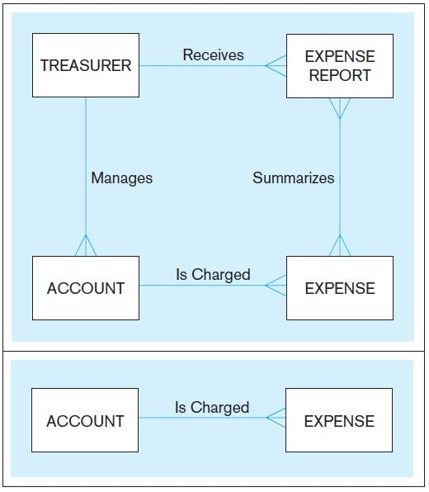
System
user
System output
Inappropriate entities
Figure 2-4 Example of inappropriate entities
Appropriate entities

Slide 18

STRONG VS. WEAK ENTITIES, AND IDENTIFYING RELATIONSHIPS
Strong entity:
exists independently of other types of entities
has its own unique identifier
    identifier underlined with single line
Identifying relationship:
  links strong entities to weak entities
Weak entity:
  dependent on a strong entity (identifying owner)…cannot exist on its own
  does not have a unique identifier (only a partial identifier)
  entity box and partial identifier have double lines

Slide 19

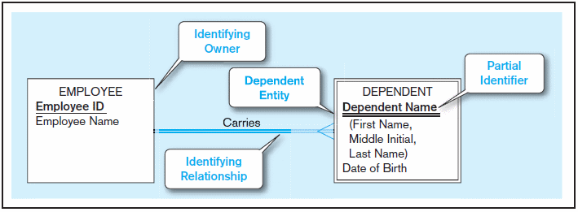
Figure 2-5 Example of a weak identity and its identifying relationship
Strong entity
Weak entity

Slide 20
Attributes 6,124$
ATTRIBUTE–property or characteristic of an entity or relationship type
Classifications of attributes:
  Required versus Optional Attributes
  Simple versus Composite Attribute
  Single-Valued versus Multivalued Attribute
  Stored versus Derived Attributes
  Identifier Attributes

Slide 21
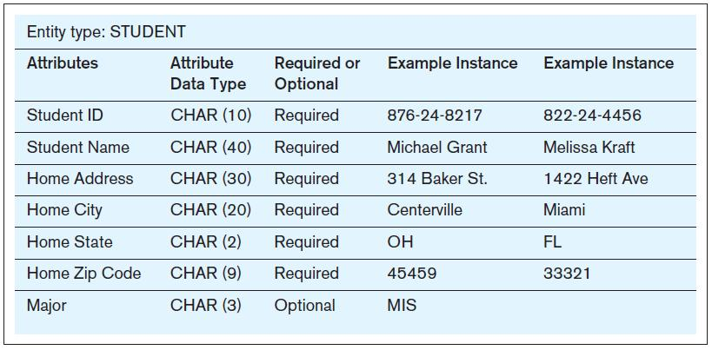
REQUIRED VS. OPTIONAL ATTRIBUTES
Required – must have a value for every entity (or relationship) instance with which it is associated
Optional – may not have a value for every entity (or relationship) instance with which it is associated

Slide 22
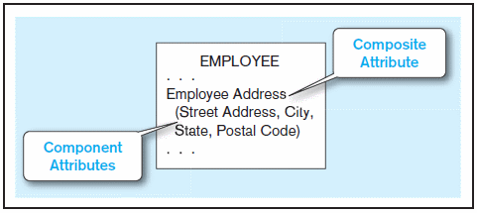
SIMPLE VS. COMPOSITE ATTRIBUTES
Composite attribute – An attribute that has meaningful component parts (attributes)
  The address is broken into component parts
Figure 2-7 A composite attribute

Slide 23
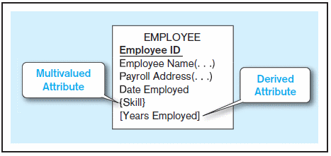
Multi-valued and Derived Attributes
Multivalued – may take on more than one value for a given entity (or relationship) instance
Derived – values can be calculated from related attribute values (not physically stored in the database)
Derived
Calculated from date employed and current date
Multivalued
an employee can have more than one skill
Figure 2-8 Entity with multivalued attribute (Skill) and derived attribute (Years Employed)

Slide 24
IDENTIFIERS (KEYS)
Identifier (Key)–an attribute (or combination of attributes) that uniquely identifies individual instances of an entity type
Simple versus Composite Identifier
Candidate Identifier–an attribute that could be a key…satisfies the requirements for being an identifier

Slide 25
Criteria for Identifiers
Choose Identifiers that
  Will not change in value
  Will not be null
Avoid intelligent identifiers (e.g., containing locations or people that might change)
Substitute new, simple keys for long, composite keys

Slide 26
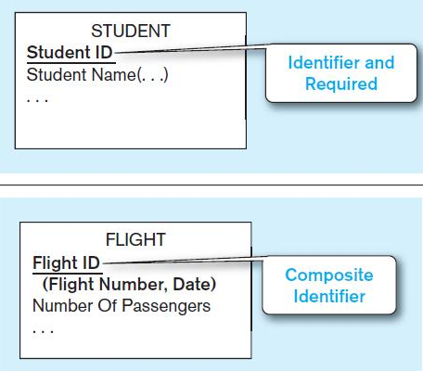
Figure 2-9 Simple and composite identifier attributes
(a) Simple Identifier Attribute
The identifier is boldfaced and underlined
(a) Composite Identifier Attribute

Slide 27
NAMING ATTRIBUTES
Name should be a singular noun or noun phrase
Name should be unique
Name should follow a standard format
  e.g. [Entity type name { [ Qualifier ] } ] Class
Similar attributes of different entity types should use the same qualifiers and classes

Slide 28

DEFINING ATTRIBUTES
State what the attribute is and possibly why it is important
Make it clear what is and is not included in the attribute’s value
Include aliases in documentation
State source of values
Specify required vs. optional
State min and max number of occurrences allowed
Indicate relationships with other attributes

Slide 29
MODELING RELATIONSHIP

Slide 30
MODELING RELATIONSHIP
Relationship Types vs. Relationship Instances
  The relationship type is modeled as lines between entity types…the instance is between specific entity instances
Associative Entity–combination of relationship and entity
Relationships can have attributes
  These describe features pertaining to the association between the entities in the relationship
Two entities can have more than one type of relationship between them (multiple relationships)

Slide 31

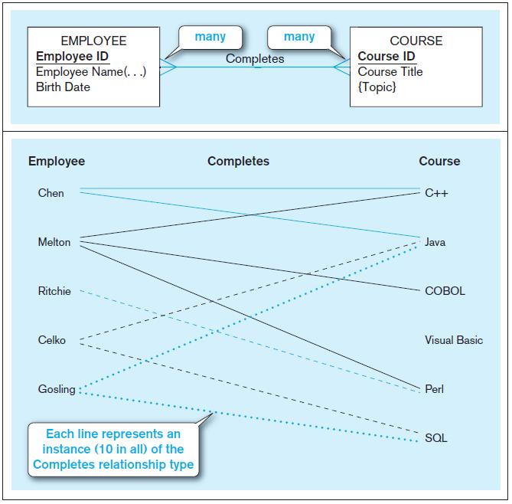
a) Relationship type (Completes)
b) Relationship instances
Figure 2-10 Relationship types and instances

Slide 32
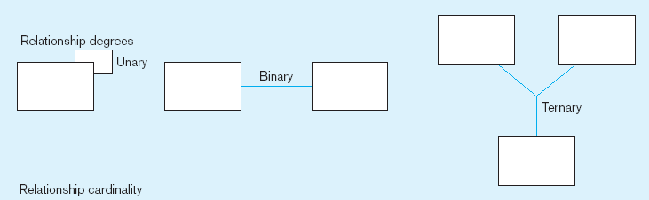
DEGREE OF RELATIONSHIPS
One entity related to another of the same entity type
Entities of two different types related to each other
Degree of a relationship is the number of entity types that participate in it
  Unary Relationship
  Binary Relationship
  Ternary Relationship
RELATIONSHIP DEGREE
UNARY
BINARY
TERNARY
Entities of three different types related to each other

Slide 33
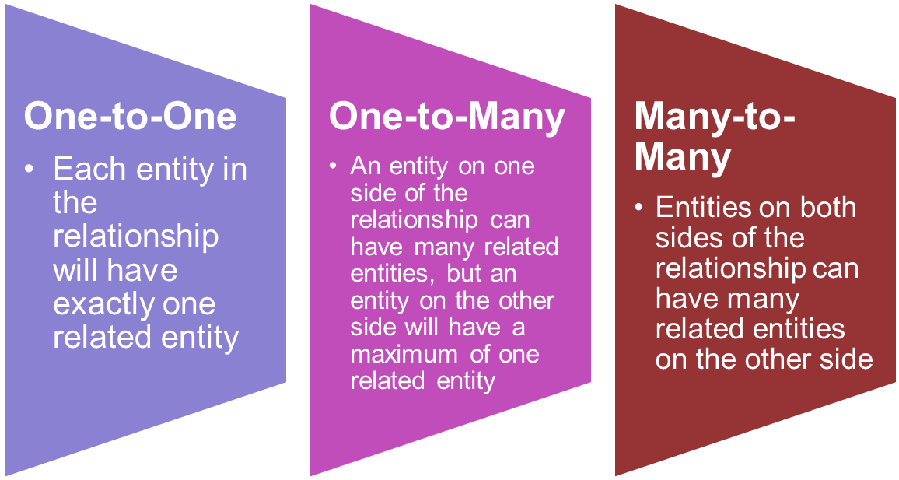
CARDINALITY OF RELATIONSHIPS

Slide 34
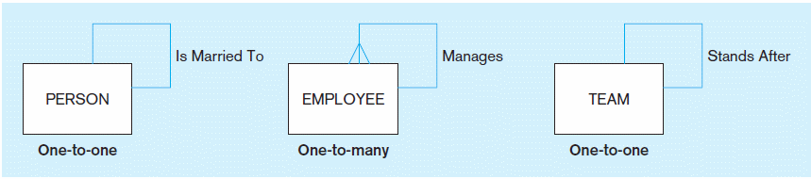
Figure 2-12 Examples of relationships of different degrees
a) Unary relationships

Slide 35
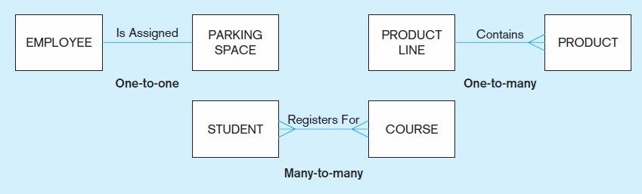
Figure 2-12 Examples of relationships of different degrees (cont.)
b) Binary relationships

Slide 36
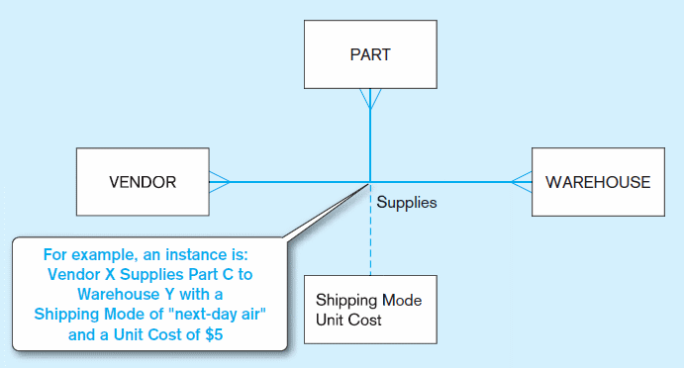
Figure 2-12 Examples of relationships of different degrees (cont.)
c) Ternary relationship
Note: a relationship can have attributes of its own

Slide 37
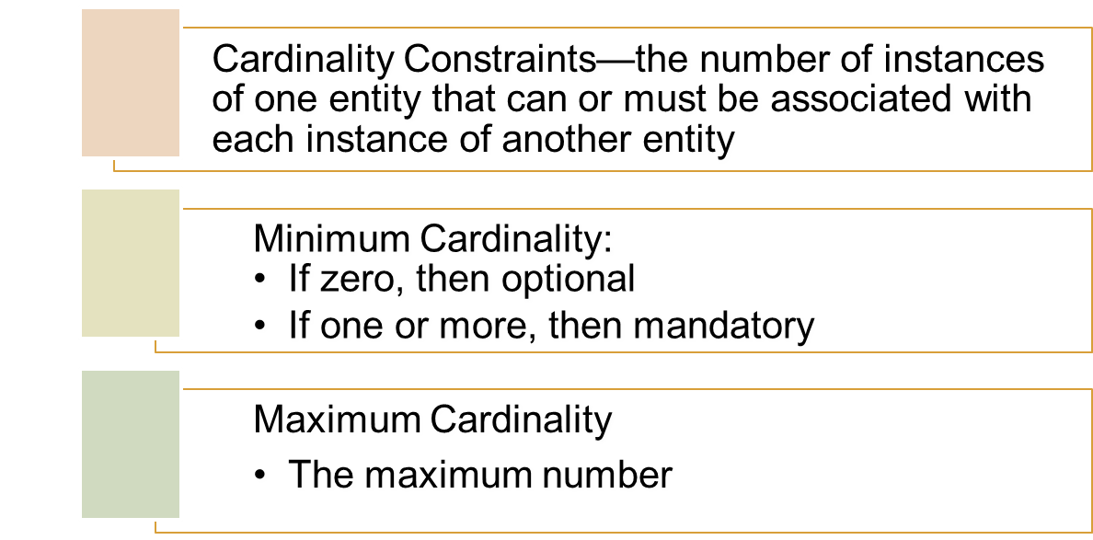
CARDINALITY CONSTRAINT

Slide 38
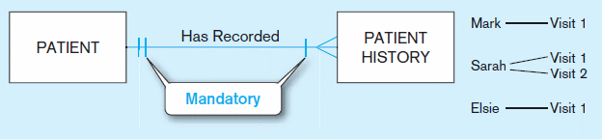
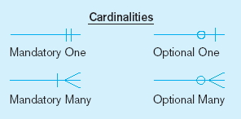
a) MANDATORY CARDINALITIES
A patient history is recorded for one and only one patient
A patient must have recorded at least one history, and can have many
Figure 2-17 Examples of cardinality constraints (cont.)

Slide 39
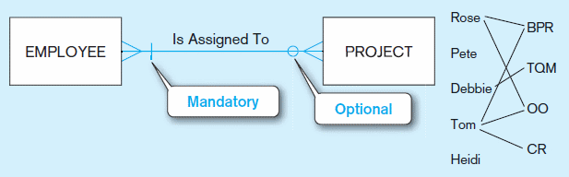
b) ONE OPTIONAL, ONE MANDATORY
A project must be assigned to at least one employee, and may be assigned to many
An employee can be assigned to any number of projects, or may not be assigned to any at all
Figure 2-17 Examples of cardinality constraints (cont.)

Slide 40
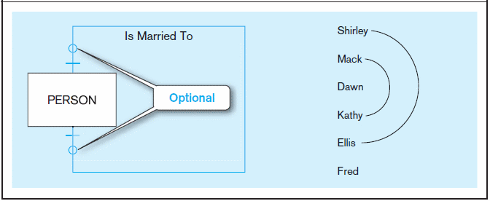
c) OPTIONAL CARDINALITIES
A person is married to at most one other person, or may not be married at all
Figure 2-17 Examples of cardinality constraints (cont.)

Slide 41
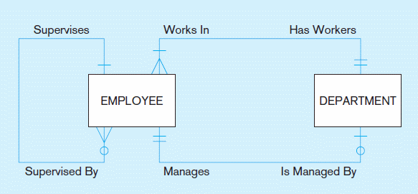
Figure 2-21 Examples of multiple relationships
a) EMPLOYEES AND DEPARTMENTS
Entities can be related to one another in more than one way

Slide 42
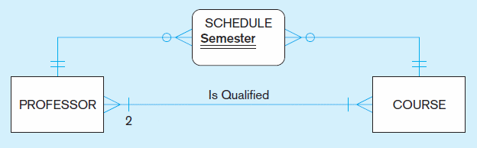
Figure 2-21 Examples of multiple relationships
a) PROFESSORS AND COURSES (FIXED LOWER LIMIT CONSTRAINT)
Here, min cardinality constraint is 2. At least two professors must be qualified to teach each course. Each professor must be qualified to teach at least one course

Slide 43
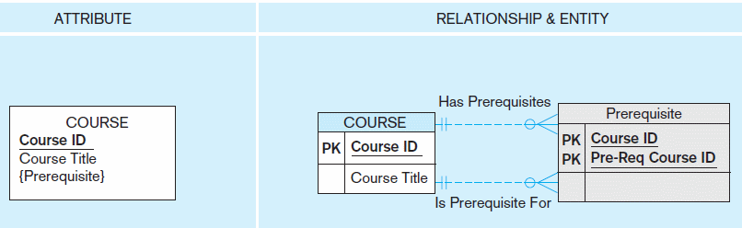
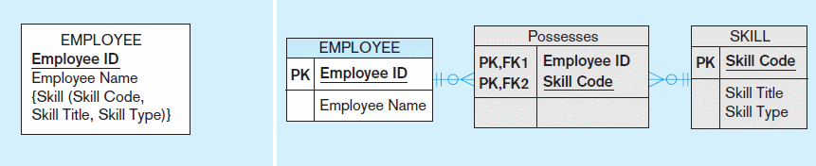
Figure 2-15a and 2-15b Multivalued attributes can be represented as relationships
simple
composite

Slide 44
ASSOCIATIVE ENTITIES

Slide 45
Associative Entities
An entity–has attributes
AND it’s a relationship–links entities together
When should a relationship with attributes instead be an associative entity?
  All relationships for the associative entity should be many
  The associative entity could have meaning independent of the other entities
  The associative entity preferably has a unique identifier, and should also have other attributes
  The associative entity may participate in other relationships other than the entities of the associated relationship
  Ternary relationships should be converted to associative entities

Slide 46
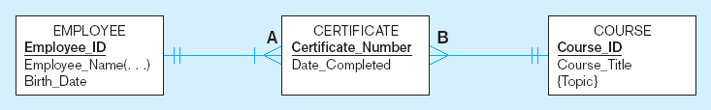
Associative entity
Associative entity is like a relationship with an attribute, but it is also considered to be an entity in its own right.
Notes:
Delta & Pine Land Company
11/25/97
21

Slide 47
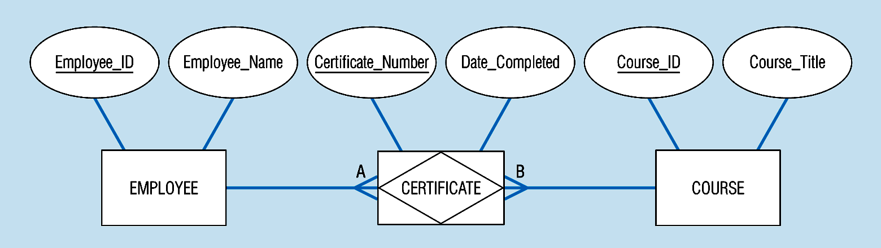
Associative entity
Associative entity involves a rectangle with a diamond inside.
Note that the many-to-many cardinality symbols face toward the associative entity and not toward the other entities
Notes:
Delta & Pine Land Company
11/25/97
21

Slide 48
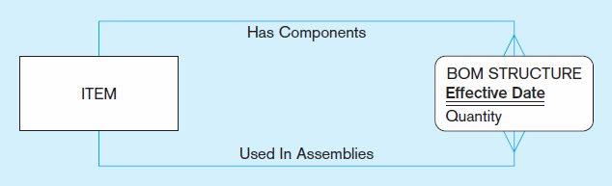
Figure 2-13c An associative entity – bill of materials structure
This could just be a relationship with attributes…it’s a judgment call.
Chapter 2
© 2013 Pearson Education, Inc. Publishing as Prentice Hall
Notes:
27

Slide 49
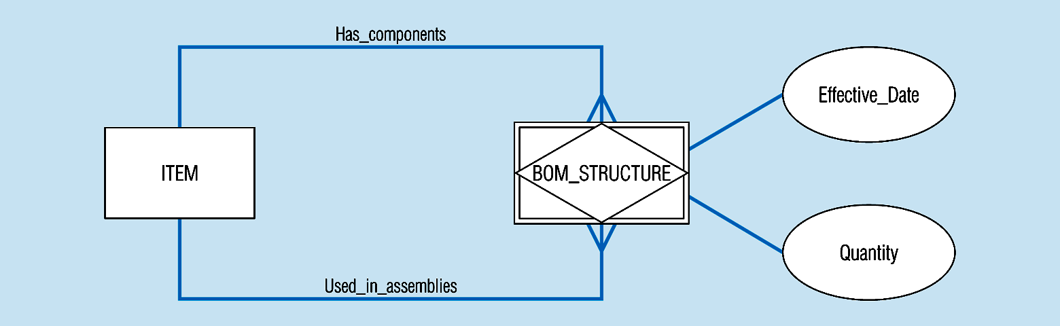
Associative Entity
This is the Bill of Materials laid out a different way. It could just be a relationship with attributes…it’s a judgment call
Notes:
Delta & Pine Land Company
11/25/97
27

Slide 50
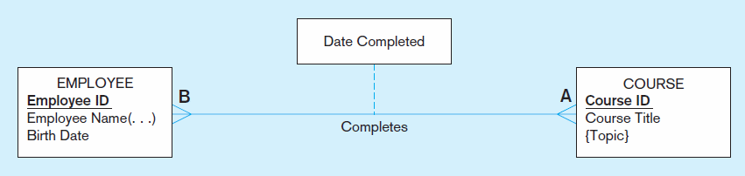
Figure 2-11a A binary relationship with an attribute
Here, the date completed attribute pertains specifically to the employee’s completion of a course…it is an attribute of the relationship.
Chapter 2
© 2013 Pearson Education, Inc. Publishing as Prentice Hall
Notes:
20

Slide 51
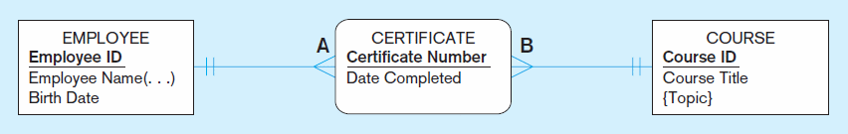
Figure 2-11b An associative entity (CERTIFICATE)
Associative entity is like a relationship with an attribute, but it is also considered to be an entity in its own right.
Note that the many-to-many cardinality between entities in Figure 2-11a has been replaced by two one-to-many relationships with the associative entity.
Notes:
21

Slide 52
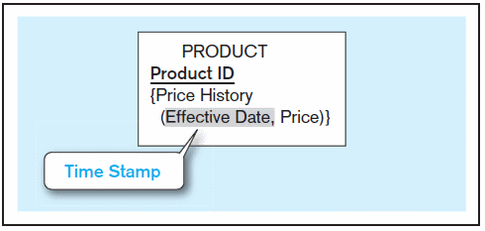
Figure 2-19 Simple example of time-stamping
Time stamp – a time value that is associated with a data value, often indicating when some event occurred that affected the data value
The Price History attribute is both multivalued and composite.
Notes:
37

Slide 53
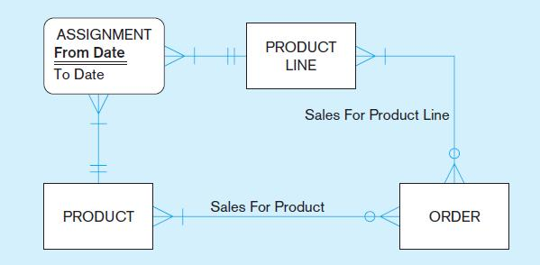
Figure 2-20c E-R diagram with associative entity for product assignment to product line over time
The Assignment associative entity shows the date range of a product’s assignment to a particular product line.
Modeling time-dependent data has become more important due to regulations such as HIPAA and Sarbanes-Oxley.
Chapter 2
Notes:
37

Slide 54
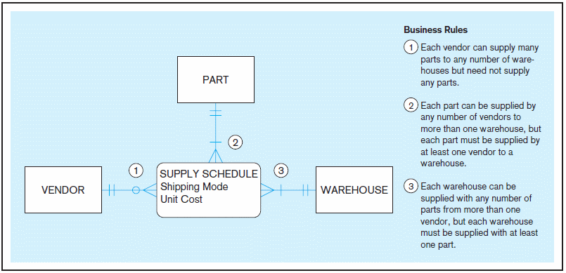
Ternary as Associative Entity
Notes:
Delta & Pine Land Company
11/25/97
36

Slide 55
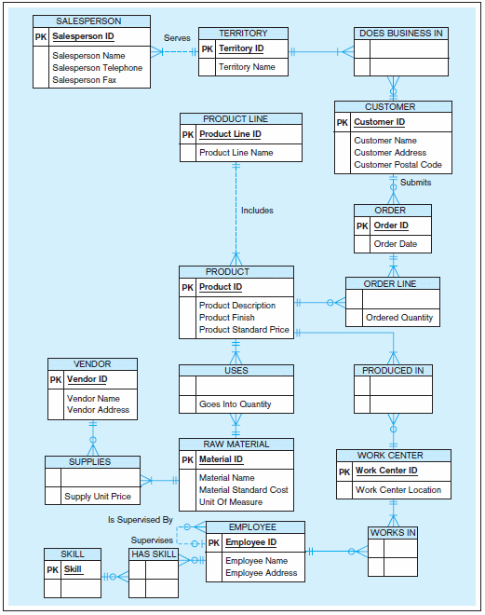
Figure 2-22
Data model for Pine Valley Furniture Company in Microsoft Visio notation
Different modeling software tools may have different notation for the same constructs.
© 2013 Pearson Education, Inc. Publishing as Prentice Hall

Slide 56
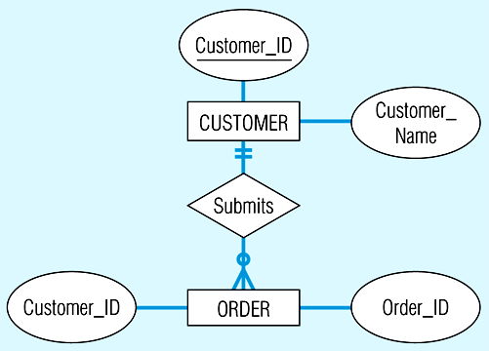
Notation used in earlier edition of our textbook – what’s different?
Notes:
Delta & Pine Land Company
11/25/97

Slide 57
Different notation
CUSTOMER
* Customer ID
Customer name
ORDER
* Order ID
Order Date
Notes:
Delta & Pine Land Company
11/25/97

Slide 58
Third style of notation
Customer ID
Customer name
CUSTOMER
1
SUBMITS
M
ORDER
Order ID
Order date
Notes:
Delta & Pine Land Company
11/25/97

Slide 59
Oracle notation
CUSTOMER
#Customer_ID
*Customer Name
ORDER
#Order_ID
*Order Date

Slide 60
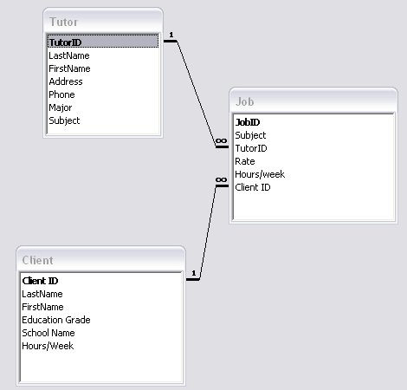
Access Notation

Slide 61
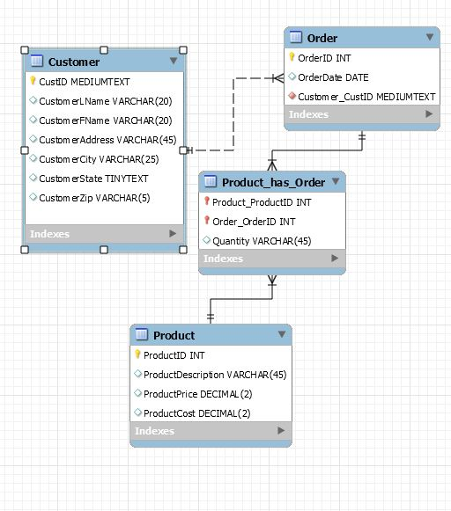
MySQL Notation

Slide 62

Copyright © 2013 Pearson Education, Inc. Publishing as Prentice Hall

